Slide 1
Les Centres de données
Data centers

Slide 2
Qu’est-ce qu’un data center?
Site physique qui contient du matériel informatique

Slide 3
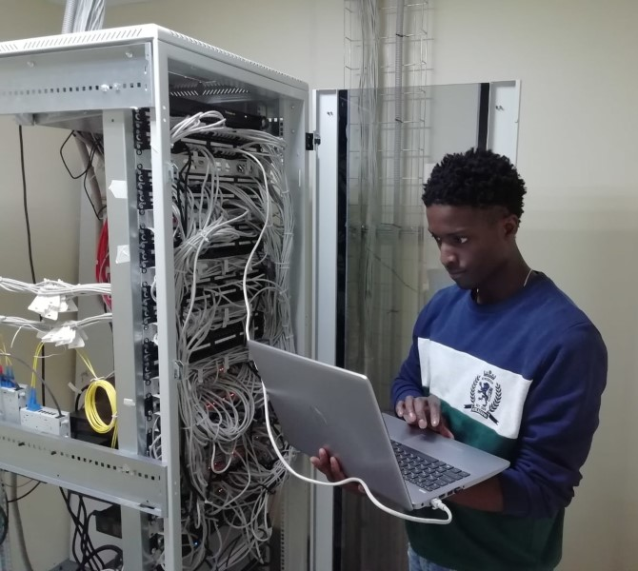
Types de data centers
Petite echelle
Salle de serveurs

Slide 4
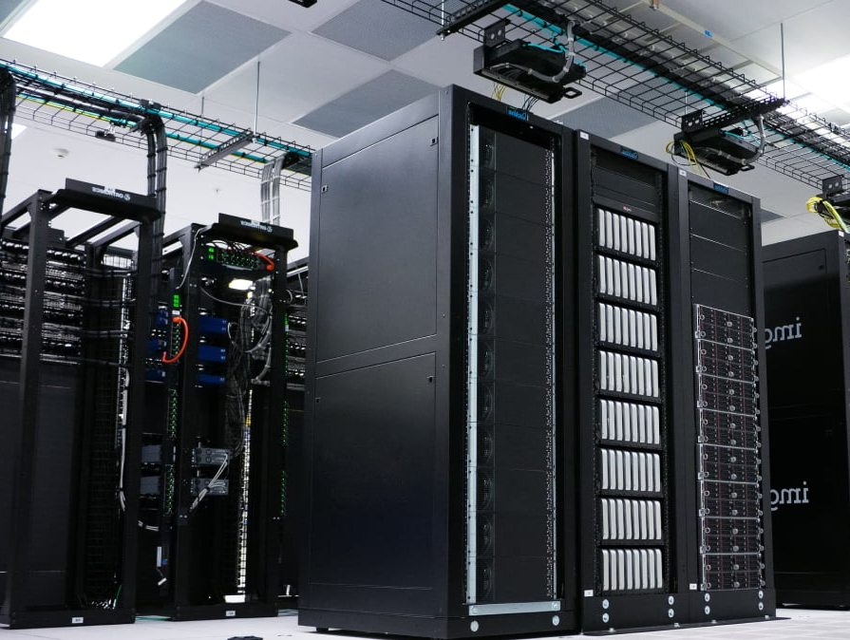
Types de data centers
Moyenne echelle
Data center d’entreprise

Slide 5
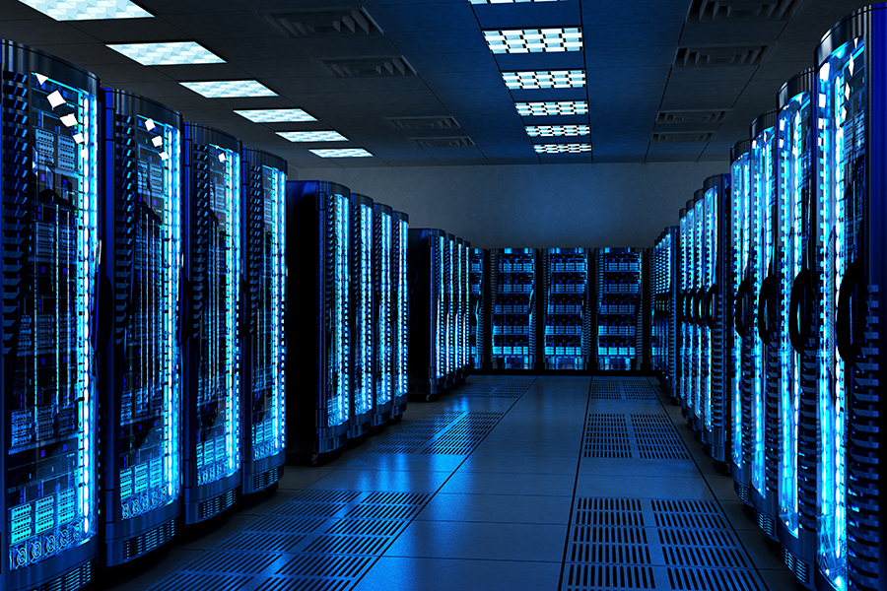
Types de data center
Grande échelle
Cloud et
Colocation

Slide 6
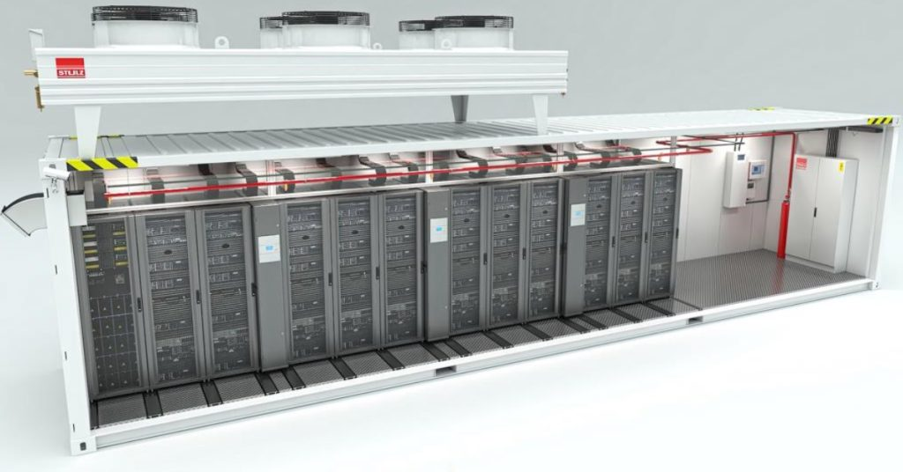
Data center modulaire
Grande échelle
Cloud et
Colocation

Slide 7
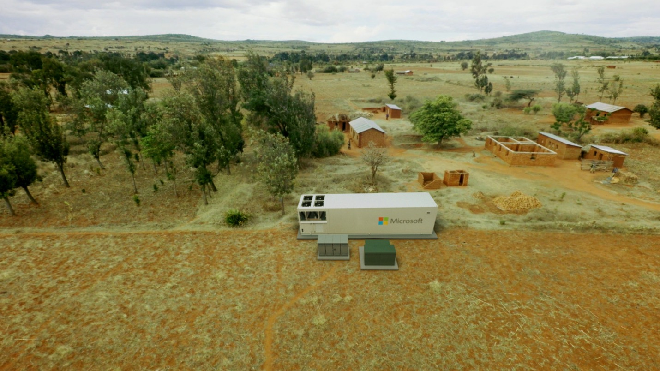
Data center modulaire
Petite échelle
Grande échelle
Cloud et
Colocation

Slide 8
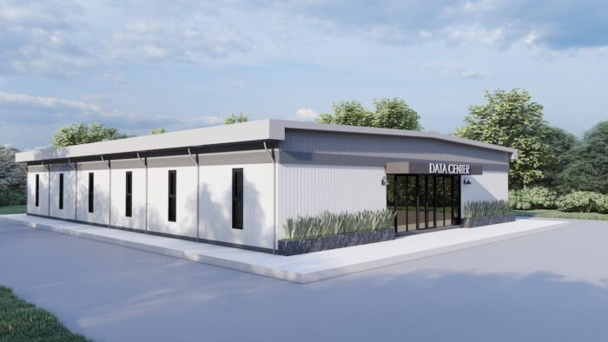
Data center modulaire: passage à l’échelle
Moyenne échelle

Slide 9
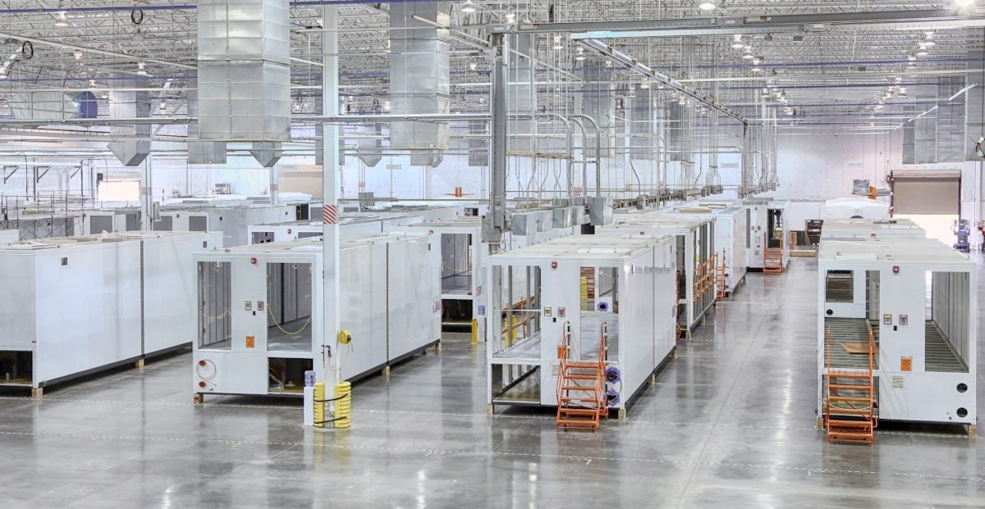
Data center modulaire: passage à l’échelle
Grande échelle

Slide 10
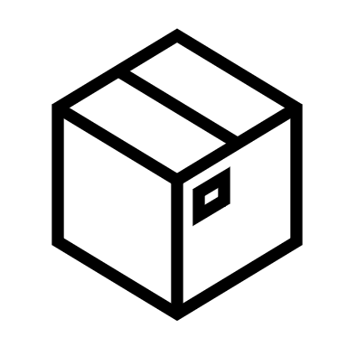
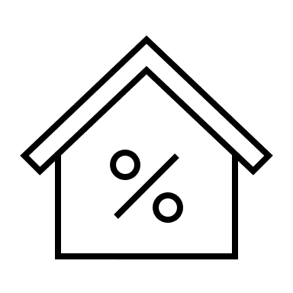

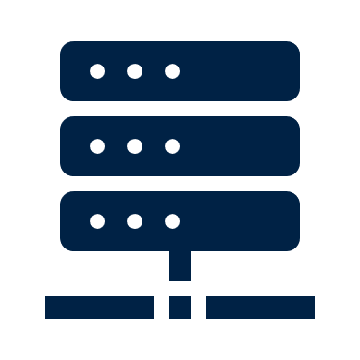
Typologie de data center
Server rooms/closets
Edge nodes
Modular (containerized) data centers
Enterprise data centers
Commercial (colocation) data centers
Hyperscale data centers
Description:
A small room or space that houses servers, network devices, and other IT equipment for an organization or government.
Typical size:
Server closet ≤ 20kW
Server room ≤ 1MW
Description:
A facility limited in scope, typically located closer to end users than larger colocation, government or enterprise data centers.
Typical size:
Small edge node (e.g, for IoT) ≤ 100kW
Larger regional/ cache site ≤ 2MW
Description:
A portable method of deploying data center capacity, most commonly within a commercial container and delivered as a turn-key product.
Typical size:
Typically 100kW but can be expanded
Description:
A facility owned and operated by the organization or enterprise it supports and often built on site.
Typical size:
From 10 cabinets (server room/closet) up to 40MW
Description:
A physical facility offering space, power, cooling, networking, and security to host data infrastructure for enterprises. Capacity is sold in the form of cabinets, cages, or private suites.
Typical size:
Retail: for customers of up to 1MW requirements; wholesale: for larger customers
Description:
Any data center containing 5,000 servers, spanning a minimum of 10,000 square feet (930 square meters) and offering at least 40MW of capacity (but often bigger).
Typical size:
At least 40MW but can exceed 100MW.

Slide 11
Le Cloud

Slide 12
Qu’est-ce que le Cloud?
Ressources informatiques fournies à la demande à travers un réseau
-ou-
La fonctionnalité à portée de main

Slide 13
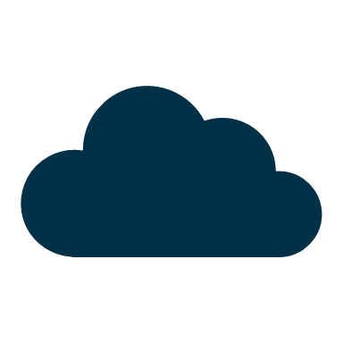
À quoi sert le cloud ?
Le cloud est devenu un prérequis pour presque tous les cas d'utilisation nécessitant une grande puissance de calcul, de l'agilité, de la disponibilité, de l'évolutivité ou de la flexibilité :
IoT
Intelligence artificielle (AI)
Haute disponibilité
Analyse Big Data
Réprise après sinistre
Disaster Recovery
Multi-Access Edge Computing (MEC)
Cloud-dependent
use cases
Test et développement
Expérience utilisateur (UX) fluide
Systèmes automatisés
Sécurité

Slide 14
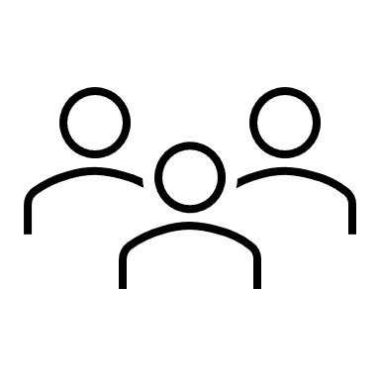
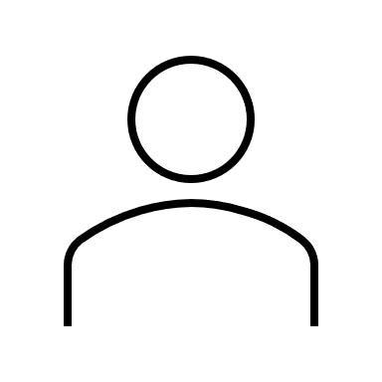
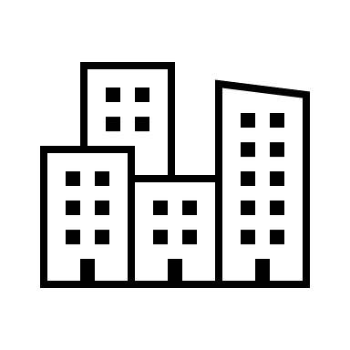
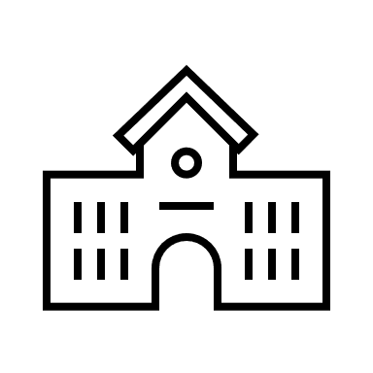
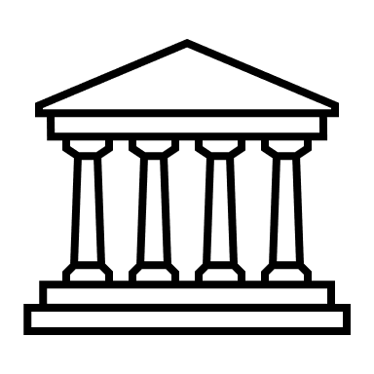
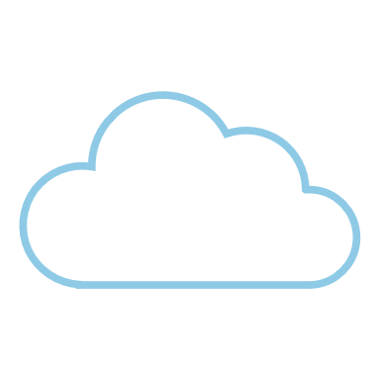
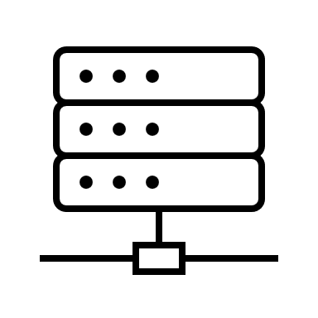
Underlying data infrastructure: overview
Users
Individuals, governments, businesses
Connection via internet
AI
Cloud layer
Analytics
Applications
Platforms
Infrastructure
The cloud: functionality at your fingertips
IoT
ML
Speed
Storage
Physical infrastructure layer
Edge node
Edge node
Hyperscaler
Local colocation DC
Notes:
The user connects to the cloud – which takes user data and distributes it to a DC, somewhere. In fact, it’s distributed to multiple data centers. Users don’t see any of this physical reality that underpins the cloud service, they just interface with the cloud software layer. The advantage is that this allows user to access ENORMOUS benefits – the cloud makes things possible that a single user would never be able to do sitting at home using just her computer. Every time she asks Chat GPT a question, for example, she is relying on the mass compute power (which requires enormous hardware investments) in a DC somewhere. But all she sees is a web interface! When she uses her email, these emails do live somewhere physically, but they are not on her phone or computer (except small local caches). In fact, her email is most likely in multiple locations—so that if one DC shuts down, her data is stored somewhere else and she continues to have uninterrupted access, blissfully unaware of the power outage or natural disaster. Moreover, on her personal computer, she probably has a password and maybe some antivirus software, and she probably keeps it locked inside her home. But her email data is much more carefully guarded—there are multiple layers of physical and digital security, access controls, sophisticated threat detection systems, cybersecurity teams working around the clock to keep her data safe. What the cloud does is abstract the user away from this physical infrastructure—all they see is the cloud interface.

Slide 15
Reality vs. Myth
Reality
Myth
What is cloud?
Storage and compute resources provisioned on demand over a network
Cloud is just for data storage
Associated data infrastructure is not operated by the end user
Only hyperscalers provide cloud services
Public vs. private cloud
Private cloud: infrastructure provisioned for exclusive use by a single organization. The infrastructure may be owned, operated and managed by the organization, a third party, or a mix of both. It can be on- or off-premises.
You need to own and operate the infrastructure to have a private cloud
Public cloud is (necessarily) less secure than private cloud
Public cloud providers cannot offer private cloud services
Public cloud: infrastructure is provisioned for open use by the general public. It exists on the premises of the cloud provider.
What is data infrastructure?
Physical location that contains computing machines and related hardware
All data centers can be made green or cloud-enabled
You need data centers in your country in order to access cloud services securely
Infrastructure underlying the cloud, ranging from small server rooms to massive hyperscaler data centers

Slide 16
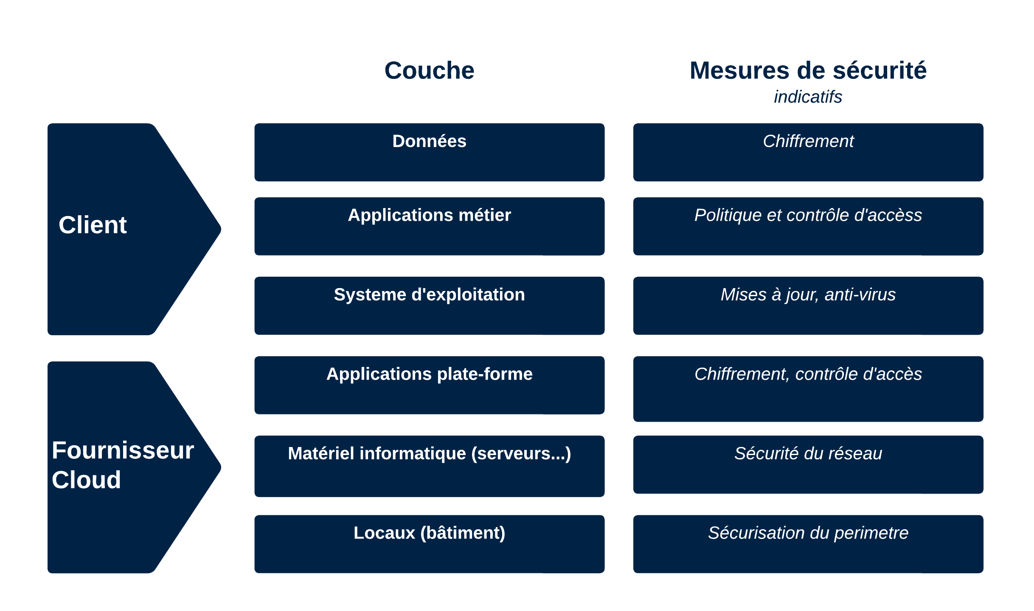
Architecture d’un système d’information

Slide 17
Sécurité d’un système d’information

Slide 18
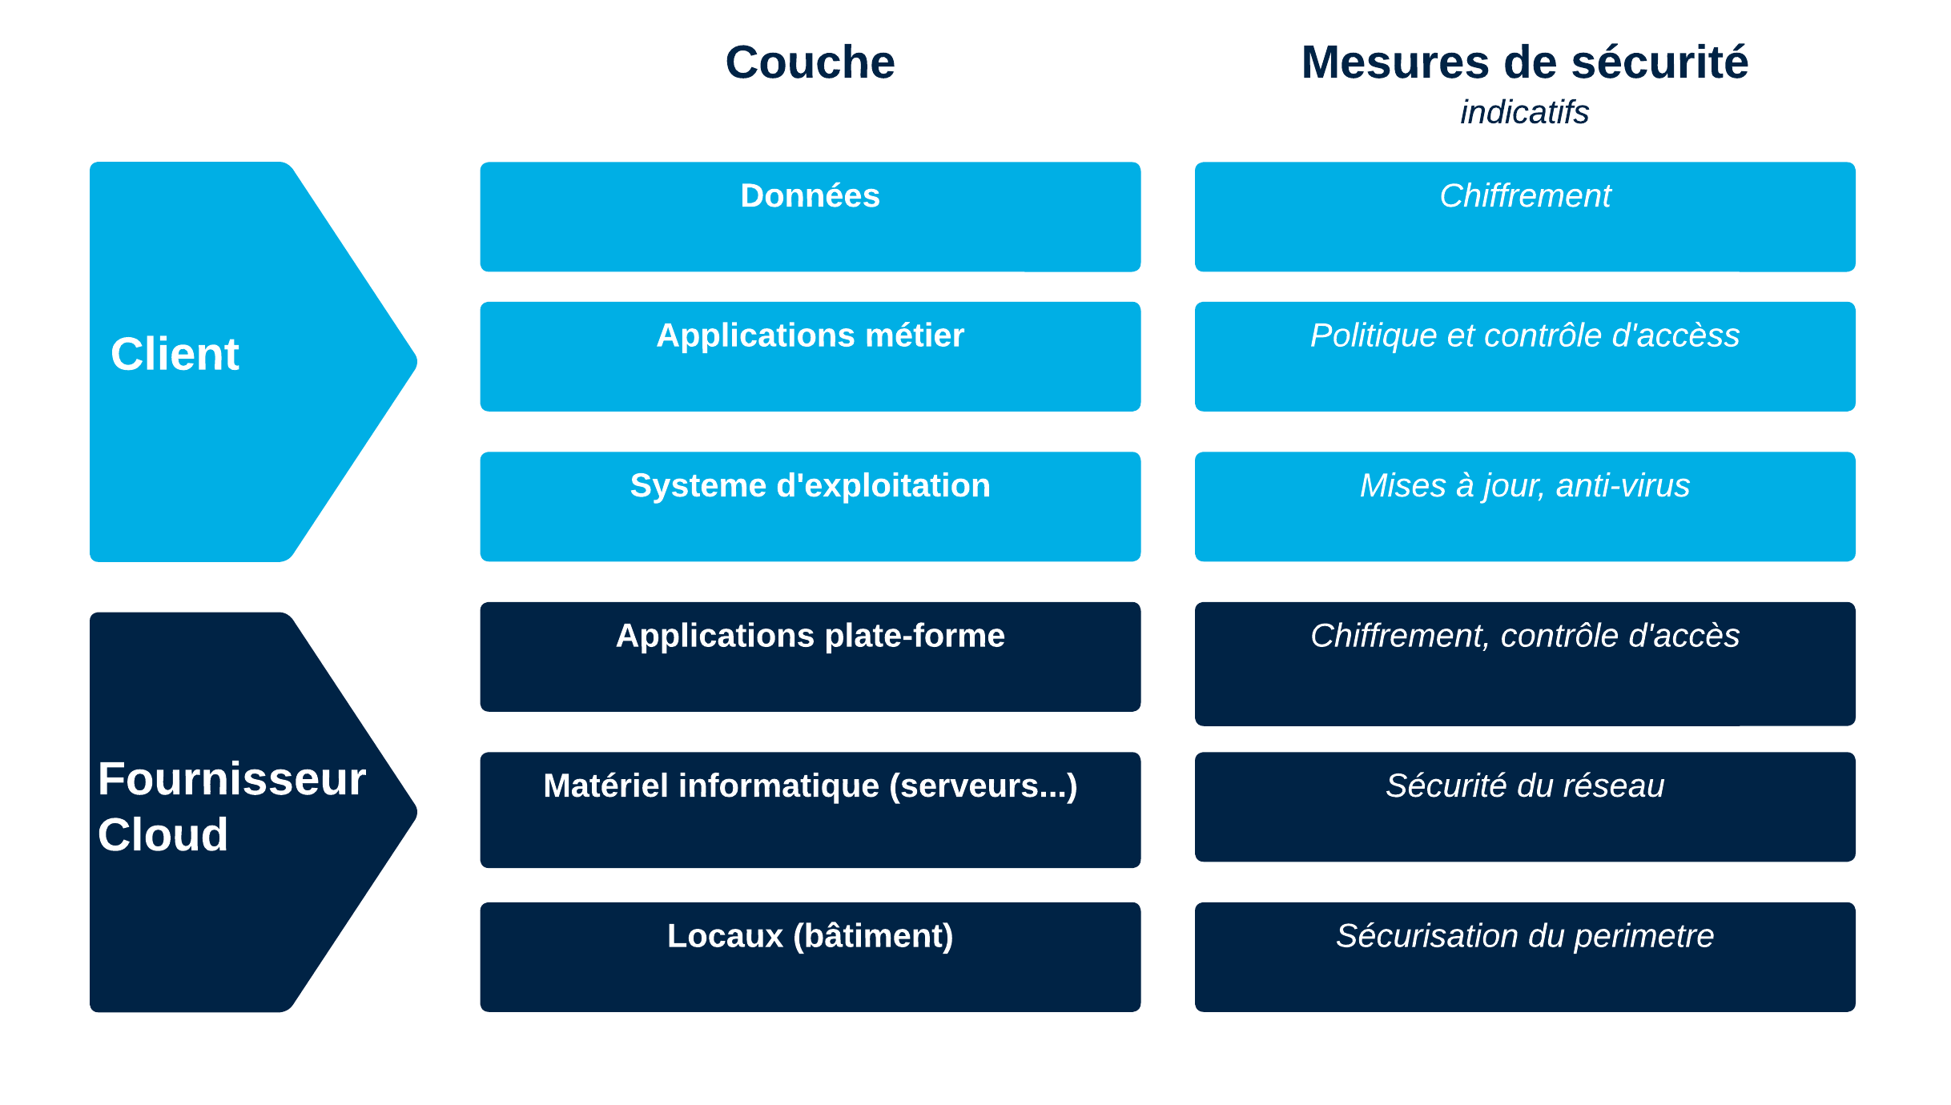
Sécurité dans le cloud : une responsabilité partagée

Slide 19
Hébergement sécurisé de données : points clés
Le contrôle physique exercé sur les locaux ne garantit pas la sécurité d’un data center
La sécurité physique est difficile à assurer pour les data centers à petite échelle
La sécurité est toujours une responsabilité partagée entre tous les acteurs
Le propriétaire de l'application crypte les données :
le fournisseur de cloud ne voit pas les données !
La répartition géographique des data centers (y compris transfrontalière) est un ingrédient clé de la cyber-résilience
Quel que soit le modèle choisi, il faut veiller au respect des normes de sécurité (y compris audite)

Slide 20
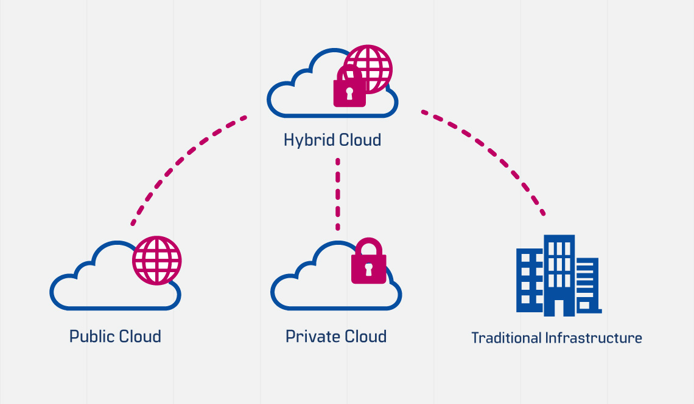
Tendance actuelle : le « Cloud hybride »

Slide 21
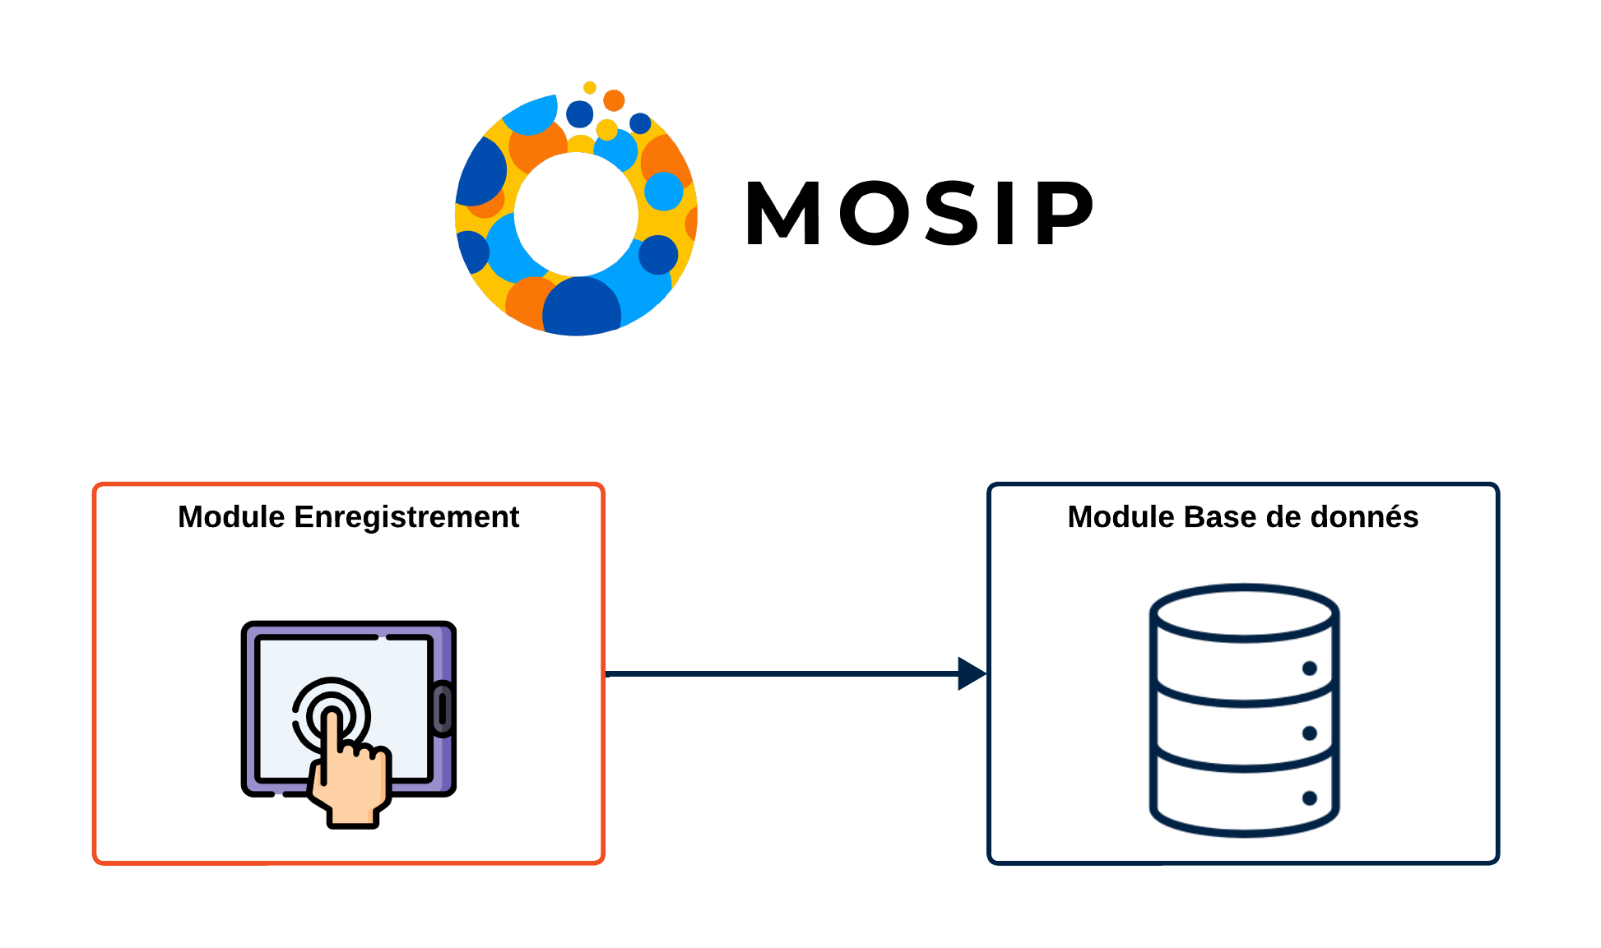
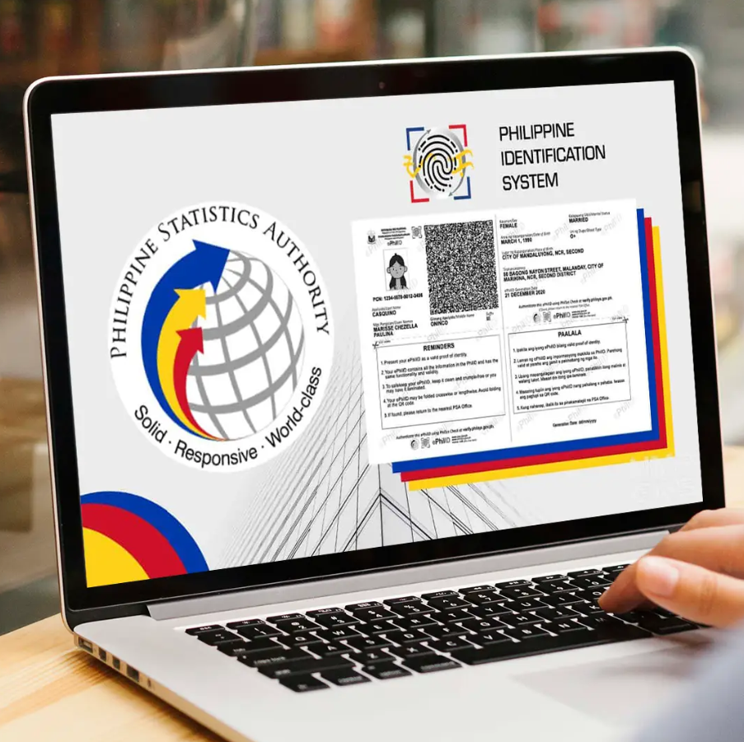
Étude de cas: Philippines (PhilSys)

Slide 22
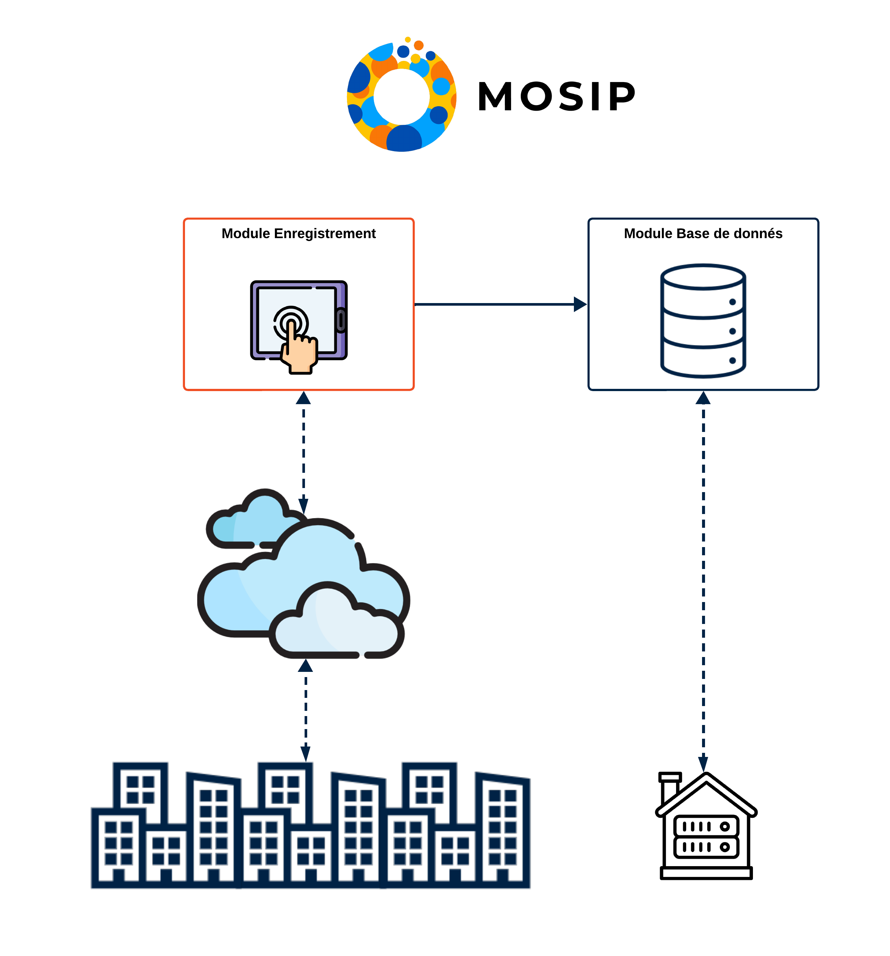

Étude de cas: Philippines (PhilSys)

Slide 23
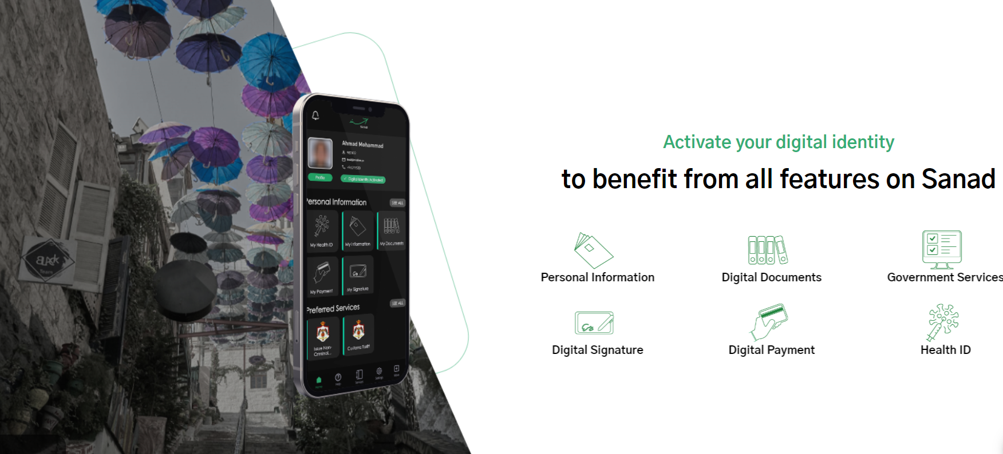
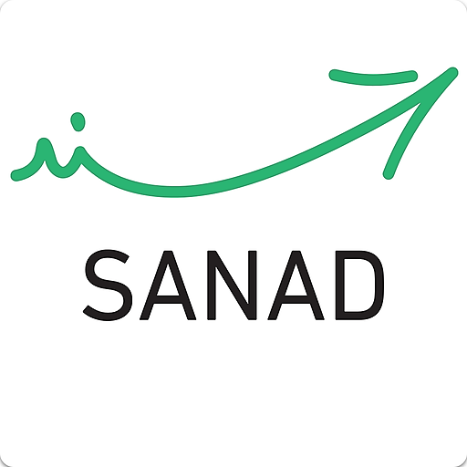
Étude de cas: Jordanie (Sanad)
Chris to add

Slide 24
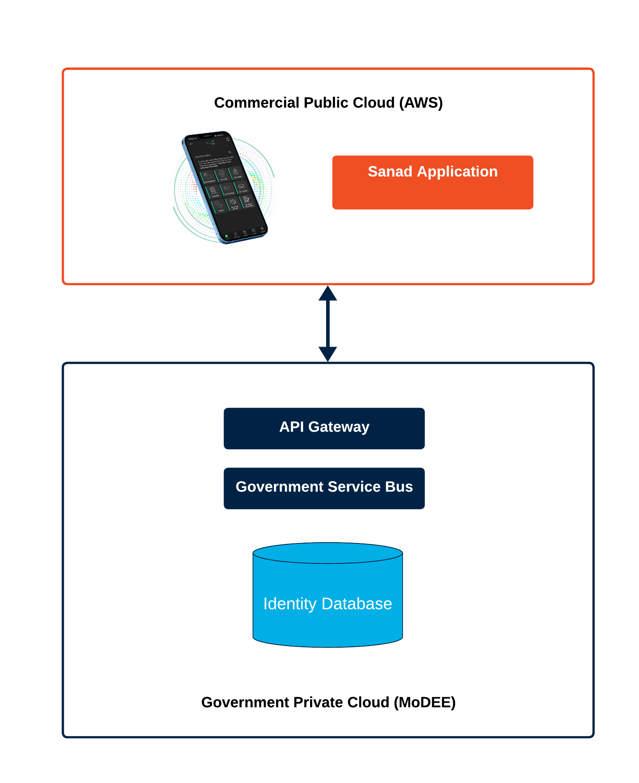
Étude de cas: Jordanie (Sanad)

Slide 25
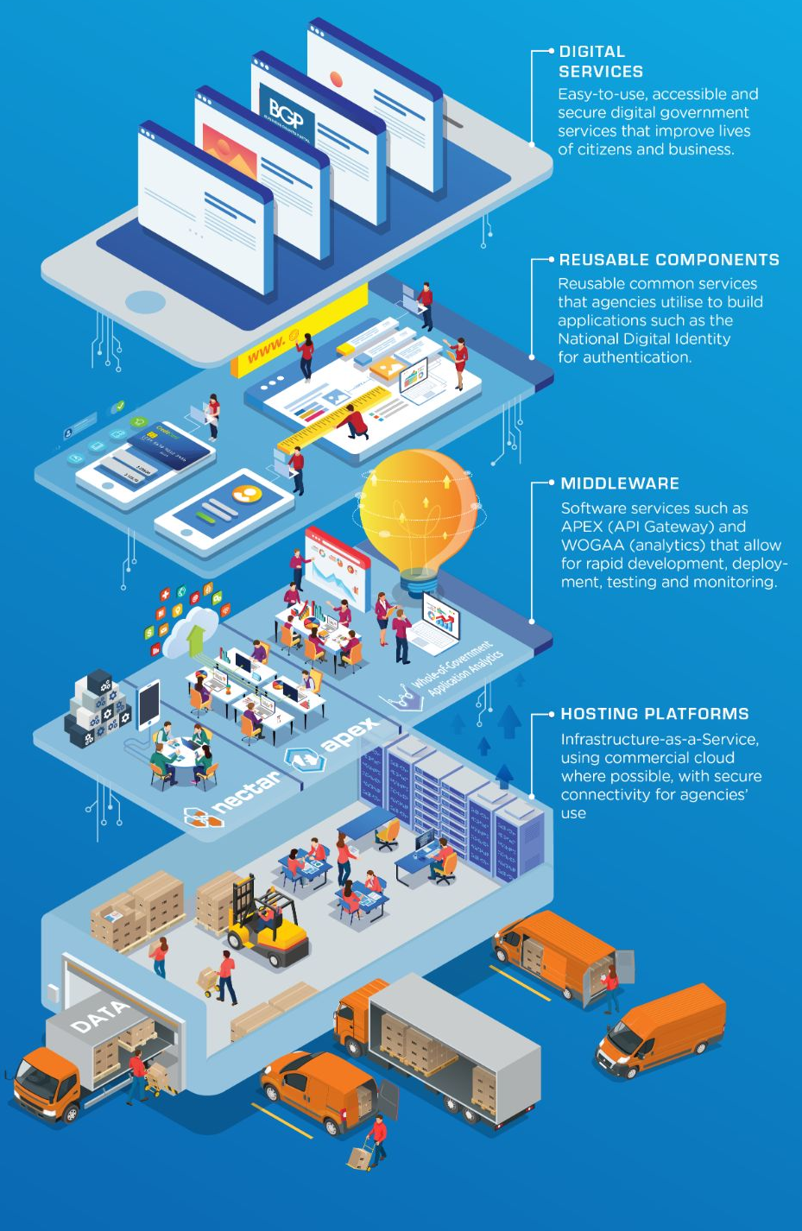
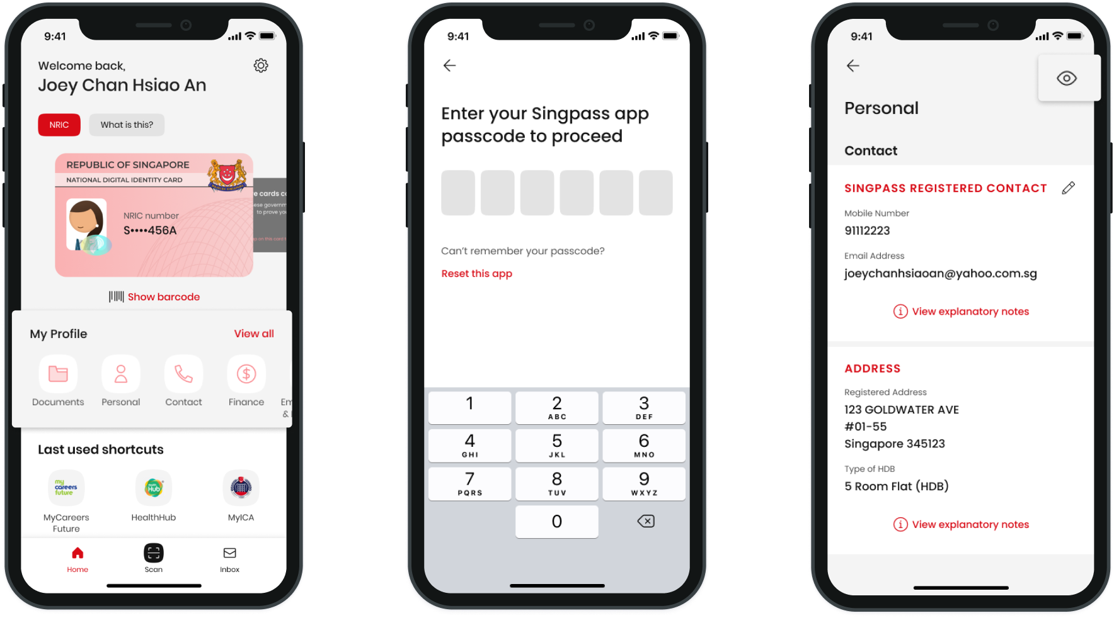
Étude de cas: Singapour (SingPass)
SingPass : cloud hybride
  Base de données d'identité sous-jacente : sur site
  Application, backend : AWS
70 % des administrations publiques dans le cloud commercial
Cloud gouvernementale déployée sur l'infrastructure privé

Slide 26
Résumé et recommendations
Éviter les salles de serveurs : performance, coût, sécurité
Prendre en compte l'évolutivité et la capacité interne des institutions publiques
Tendance internationale marqué vers les modèles hybride
De nombreux modèles permettant au secteur privé de jouer un rôle sans compromettre la souveraineté

Slide 27
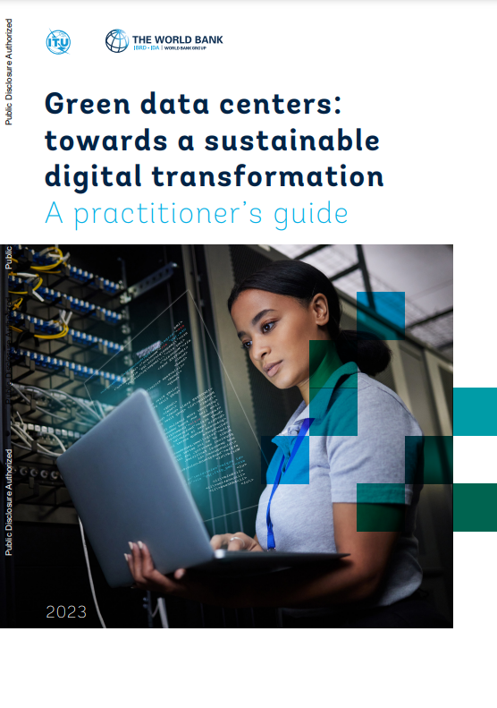
Résumé des ressources existantes et en cours
Rapport phare sur le Cloud
Rapport sur les centres de données écologiques
Note explicative sur la sécurité du Cloud
Modèle d'offre et de demande pour les data centers
Cartographie de la chaîne de valeur du Cloud pour l'Afrique
Tendances de l'adoption de Cloud par les gouvernements

Slide 28

Merci beaucoup !
Christopher Tullis
Spécialiste principal en transformation numérique
ctullis@worldbank.org

